Slide 1

Lecture 5: Search II
Monday 6:30-9:00
EAS 230

Slide 2
How to Solve AI Tasks?
Lecture 2&3
Lecture 4-7
Lecture 8-9
Lecture 10-13
Search problems
Bayes Networks
Logic
MDP
Deep learning
State-based models
Variable-based models
“Virtual Assistant”
Reflex
"low level AI"
"high level AI"
Handles complicated logics
Reflex
Reflex
Machine learning
Notes:
still will continue the reflex based model

Slide 3
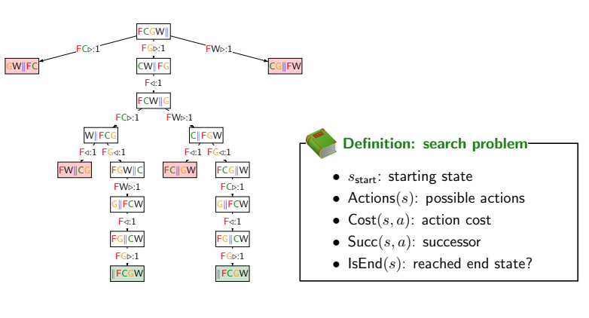
Lecture 4 Recap: Formulating a Search Problem
Notes:
formalize a search problem what are things we need to keep track of
start state,
∂actions which return all possible actions from a state,
cost function take a state and an action, tells what’s the cost of that,
successor function, take a state and action tells me where we end up have.
isend function tells us if we are an end state, don’t have possible actions

Slide 4
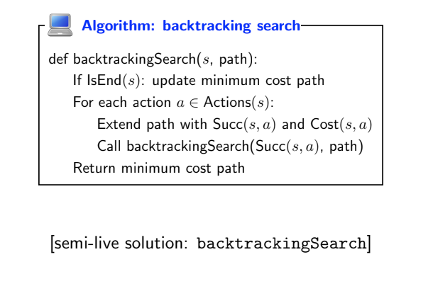
Lecture 4 Recap: Backtracking search
Notes:
let’s go back to the tram example
[go back to notebook]

Slide 5
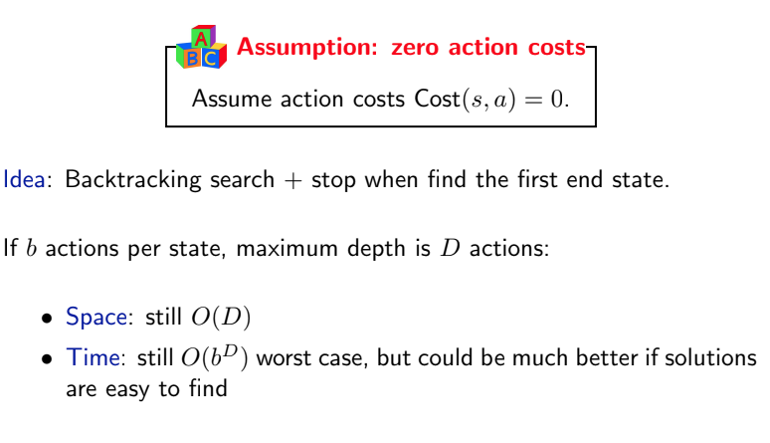
Lecture 4 Recap: Depth-first search
Notes:
the restriction that dfs puts in is the cost has to be 0
[whiteboard, go to the tree]
what dfs does it’s basically doing the same thing as backtracking but once it finds a solution down here then it’s done, because all costs are 0, if I find a solution, anything else also has cost 0. An example is rubik’s cube,
[white board, go to the table]

Slide 6
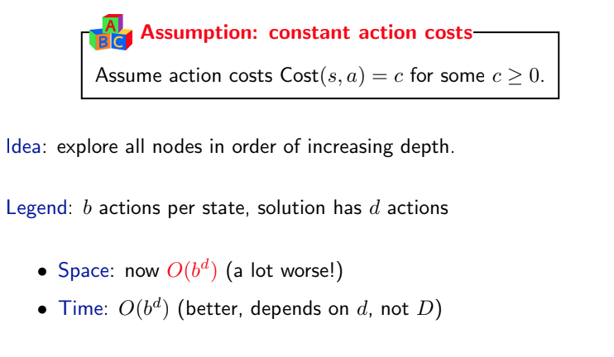
Lecture 4 Recap: Breadth-first search
Notes:
so that was dfs, we have another algorithm called bfs, which is
[whiteboard, tree] useful when cost is constant, all edges have the same cost (draw c). the idea is we can go layer by layer, the tree doesn’t have to go all the way down
will try this layer, if I find a solution here, I’m done, the solutions below will be worse than this
[whiteboard, table] the time is b to the small d, which is a huge improvement, because the tree has exponentially becomes larger, going down the layer is bad
the problem with bfs is, in terms of memory we are losing. the reason is next time I try this layer, I need to store everything above, because maybe I don’t find a solution, and I need to come down

Slide 7
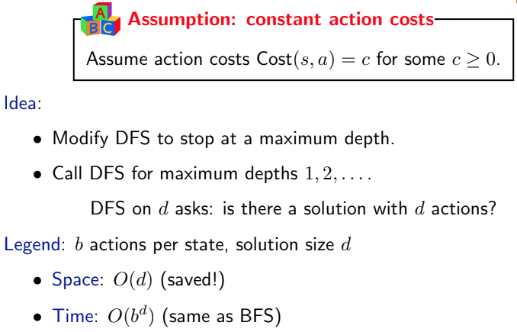
Lecture 4 Recap: Depth-first search iterative deepening
Notes:
the idea is to combine BFS with DFS
[whiteboard, tree] this algorithm goes level by level, same as dfs. for every level runs a full dfs, feels it’ll take a long time, but if you find a solution it doesn’t matter if you run a lot of dfs so far., the idea is like a dog on a leash
[whiteboard, table] discuss time and space cost
time cost should be O(d x b^d)?

Slide 8
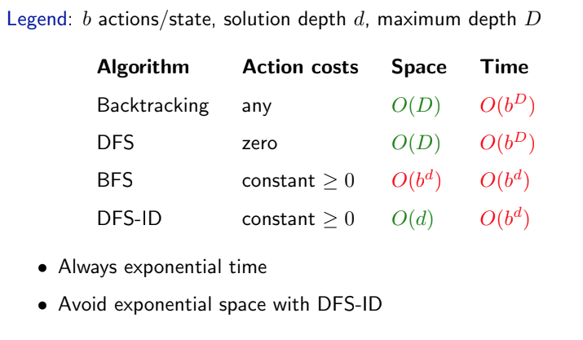
Lecture 4 Recap: Summary of cost of search
Notes:
we are not doing great in terms of time
what we want to do is to talk about search algorithms that can bring down the exponential time to polynomial time, there’s no magic, dp is the first

Slide 9
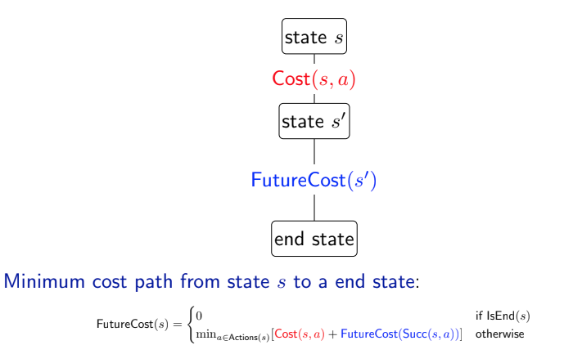
Lecture 4 Recap: Dynamic programming
[whiteboard]
Notes:
what does dp do? [whiteboard] the idea of dp is i have a state s, want to end up in some end state, to do that I can take some actions that takes me to s’, end up in s’. From there I can do something, end up in End.
what I’m interested in for state s is to find what’s the future cost of s. If I want to find what’s the future cost of s, it’s equal to [formula]…you may ask what is this a? I will pick an a that minimizes this sum over all possible actions,
so that’s how we’ll go about formalizing this problem
and then how do we find s’? remember we use the successor function, so s’ is just calling that successor function

Slide 10
Overview of Lecture 5
Uniform Cost Search (cont)
Learning
A*
Reflex
Reflex
Machine learning

Slide 11
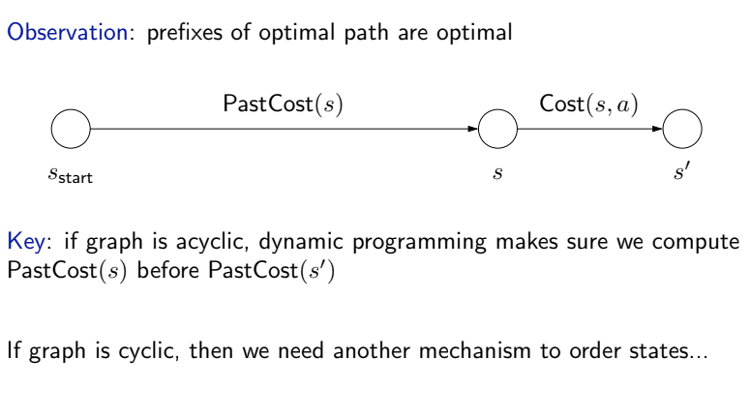
Ordering the states
Notes:
let’s look at how ucs can help with cycles. ucs is basically dijkstra
the idea is when we think about the of getting to the start state to some s’, it’s equal to the cost of going from s to s’ and some past cost
in dp these things are computed in order so we not worried about visiting the same state multiple times
in ucs, we may visit the same state multiple times, things are cyclic, we don’t know what orders to go,
the idea is to go over the state based on increasing past cost

Slide 12
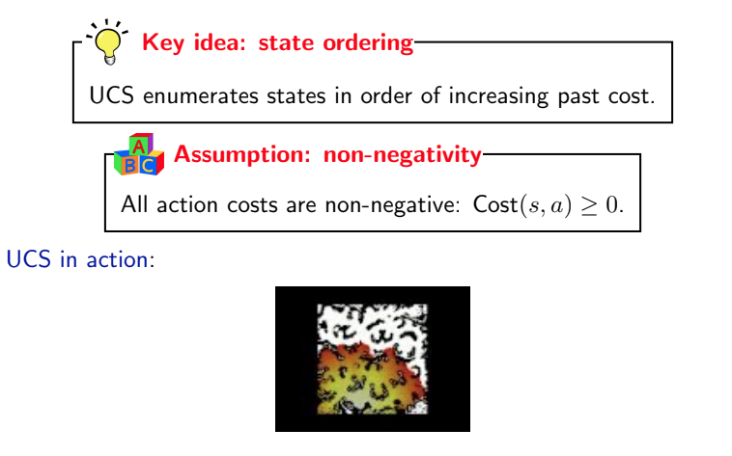
Uniform cost search (UCS)

Slide 13
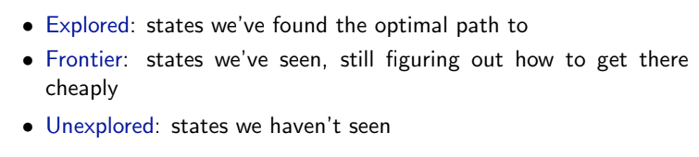
High-level strategy
frontier
explored
unexplored
Notes:
so let’s talk about the high level idea of ucs.
the ucs has three sets we need to keep track of. explored are the state we found the optimal paths, then we have another set called the frontier, the frontier of the state we’ve seen, but we are not sure that’s the best way of getting there. finally we have unexplored we haven’t seen them yet,

Slide 14
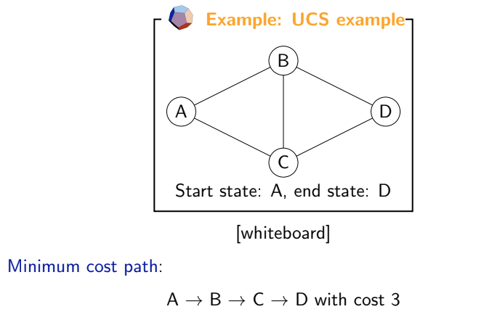
Uniform cost search

Slide 15
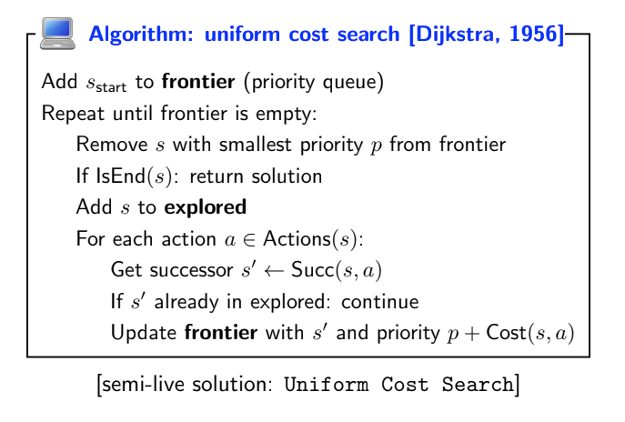
Uniform cost search
Notes:
[live demo], N = 40
difference between ucs and dijkstra, the latter find any shortest path from the starting point

Slide 16
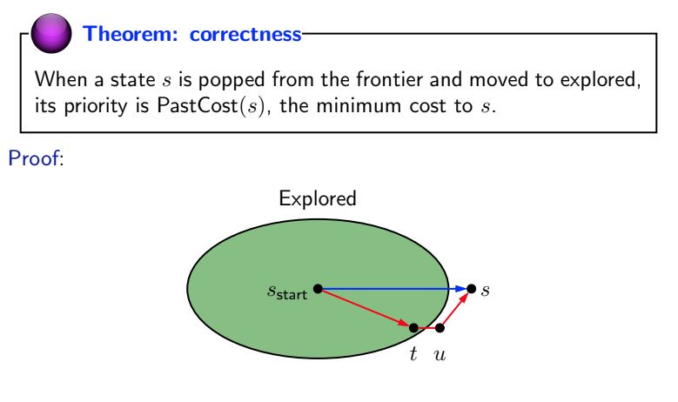
Analysis of uniform cost search
Notes:
suppose we are at the time T where s is just popped from the frontier to be added to explored. We will show that the path from s_start to s has the minimum cost.
Suppose it does not have the minimum cost, so there exists another path. At the time T, the alternative path must either go through a node t that is in explored, or a node u that is outside of explored.
If it’s t, i.e., t is the successor of s_{start}. Since t is already in explored, its successor along the path from t to s must already be in frontier. There are two cases of this successor: first, it’s just s, if this is the case, since the 2nd path is cheaper than the first path, the shortest cost path from s_{start} to s should have been updated to the 2nd path so we have a contradiction; second, if the successor is some u other than s, then the cost from s_{start} to u is smaller than the first path, so it is u that should be popped from the frontier to the explored instead of s, contradiction;
if at the time T, there does not exist a node t in explored, so the successor u of s_{start} is outside of explored. Therefore u is already in frontier. Since the cost from s_{start} to u is smaller than the cost of the first path, by the time T, u should be popped from the frontier to the explored instead of s, so there’s a contradiction.

Slide 17
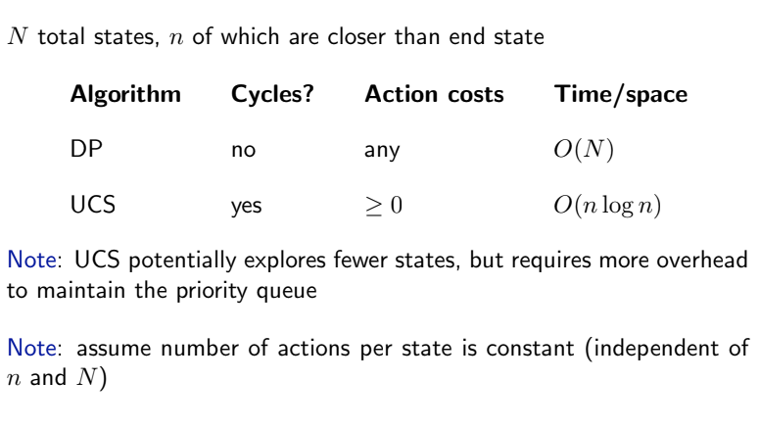
Dynamic programming vs. Uniform cost search
Notes:
different strength and weakness, neither dominates
DP:
can handle negative cost
complexity: order of N, N are all reachable states from s_{start}, but since it can handle negative cost, we can’t order the state by past cost, so this is unavoidable
UCS:
allow cycles, so cannot handle negative cost
complexity: n are the number of states where the cost of s_{start} to s are smaller than any end state, log n is due to the priority queue, n is smaller than N

Slide 18
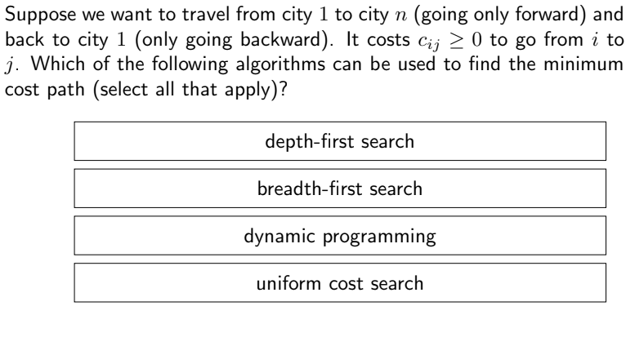
Question
Reflex
Reflex
Machine learning
Notes:
[whiteboard]
dfs: cost = 0, can’t use dfs
bfs: same cost, can’t use bfs
dp: yes, no cycles since it’s round trip
ucs: yes

Slide 19
Overview of Lecture 5
Uniform Cost Search (cont)
Learning
A*
Reflex
Reflex
Machine learning

Slide 20
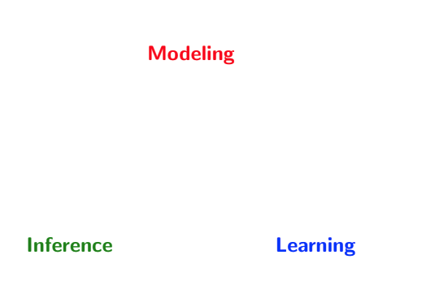
Paradigm
Notes:
paradigm of modeling, inference, and learning
for reflex based models we talked about it already: modeling: linear predictor/neural network, inference is simple, learning use gradient descent
similar thing w/ search based model, talked about search, dfs, bfs, …, next lecture is learning
(draw this on whiteboard)

Slide 21
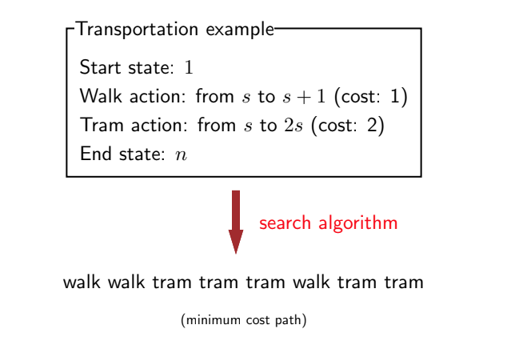
The inference problem
Notes:
last time we talked about the tram problem, and learned how to use search algorithm to find the minimum cost path, which is the inference problem, the input assumes we know the cost, and …

Slide 22
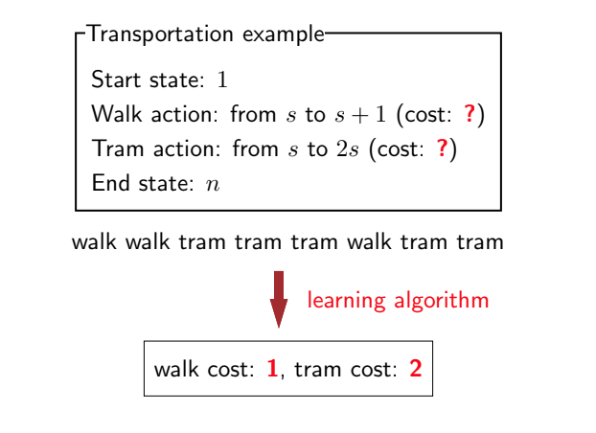
The learning problem
Notes:
the learning problem on the other hand assumes we do not know the input, but we know the minimum cost path action sequence
a common problem in ML, e.g., have data in how a person grasp an object, no idea how the person is optimizing, but has trajectory. From the trajectory can learn the cost function, and ask the robot to do the same thing

Slide 23
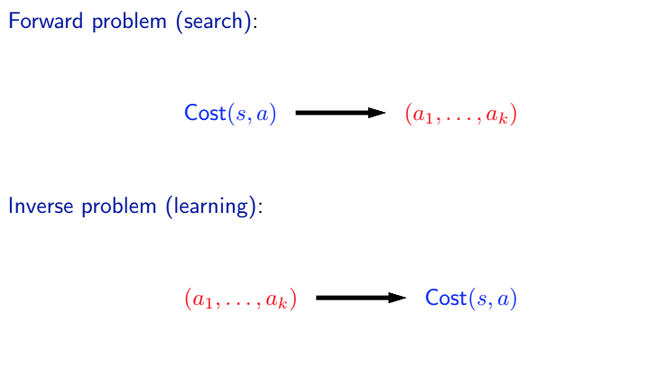
Learning is the inverse of search

Slide 24
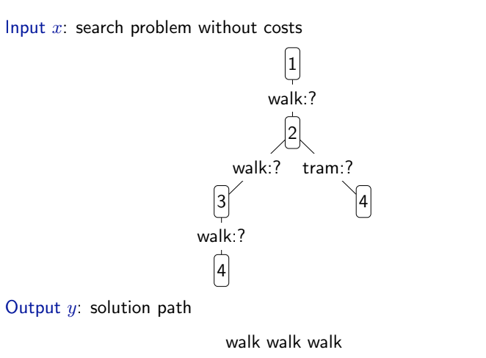
Prediction (inference) problem
[whiteboard]
Notes:
draw this on the whiteboard
one way to go about this is to start with some initialization

Slide 25
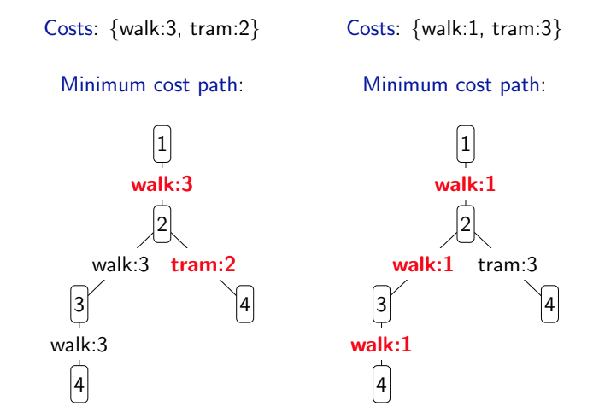
Prediction (inference) problem
Notes:
start with 3, 2 -> run the algorithm -> updated to 1, 3 -> converge, the weight doesn’t depend on state
this is a simplified version, the +- is always 1, bring up and down the same thing
we can make the weight depend on action, more generalized algorithm called structured perceptron
we got 1, 3

Slide 26
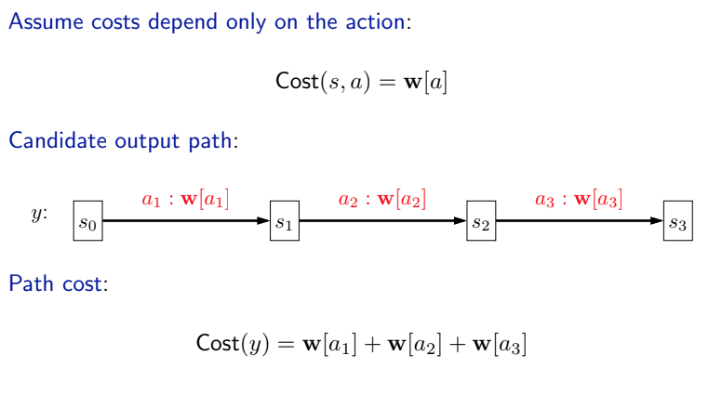
Modeling the cost
Notes:
we can assume cost only depends on action
if you take any candidate path, what’s the cost of the path?

Slide 27
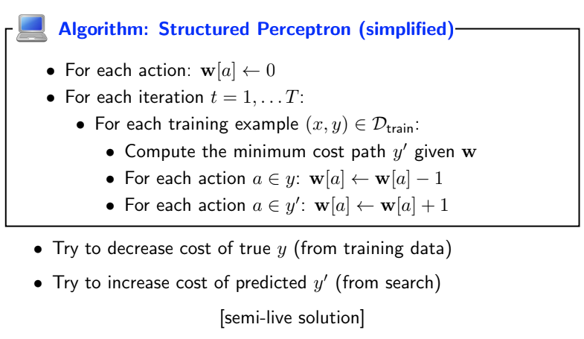
Learning algorithm
Notes:
what you can do is you can compute your prediction y’ given w
and then do +-1 type of action. If it’s in y, subtract. If it’s in prediction, increase
trueWeights = {'walk': 1, 'tram': 2}
trueWeights = {'walk': 1, 'tram': 4}: the correct portion
trueWeights = {'walk': 1, 'tram': 5}: overfit, why? increase N to 30

Slide 28
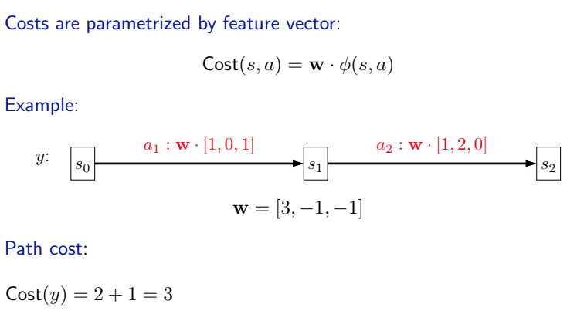
Learning algorithm (general)
Notes:
more general form of features

Slide 29
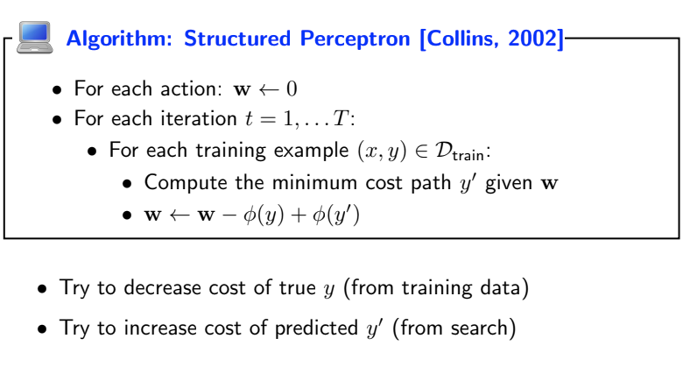
Learning algorithm (general)
Notes:
more general based on subtracting the features

Slide 30
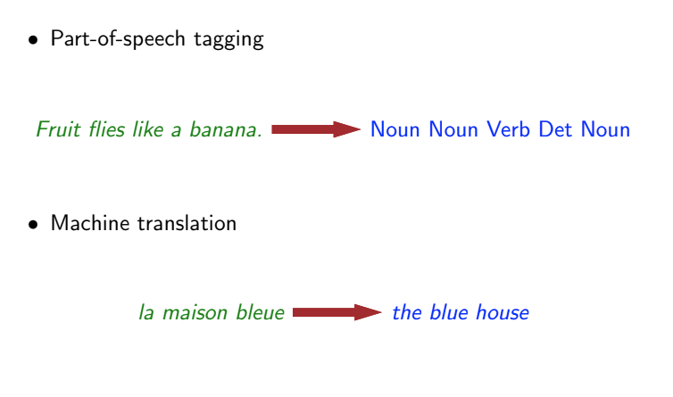
Learning algorithm (general)
Notes:
machine translation, you can upweight downweight based on training data

Slide 31
Overview of Lecture 5
Uniform Cost Search (cont)
Learning
A*
Reflex
Reflex
Machine learning

Slide 32
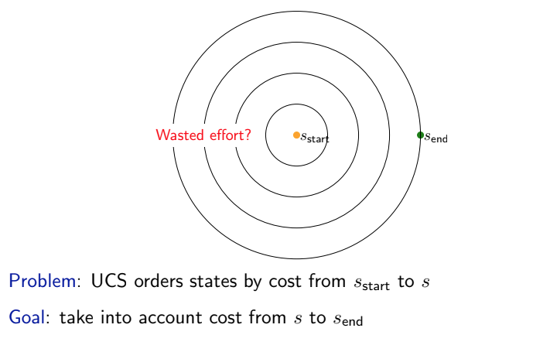
Can uniform cost search be improved?
Notes:
uniformly exploring all state possible,
As a result, it will explore many states which are close to the start state, but in the opposite direction of the end state.
Intuitively, we’d like to bias UCS towards exploring states which are closer to the end state, and that’s
exactly what A* does.

Slide 33
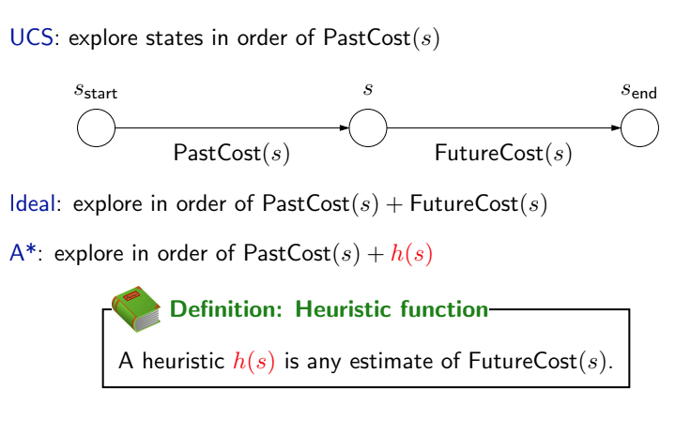
Exploring states
Notes:
we have one start state, and one end state, ucs explores all end state without considering s_end
UCS explores states in order of PastCost(s). It’d be nice if we could explore states in order of PastCost(s) + FutureCost(s), but computin FutureCost(s) would be as expensive as solving the original problem.
A* relies on a heuristic h(s), which is an estimate of FutureCost(s).
For A* to work, h(s) must satisfy some conditions, but for now, just think of h(s) as an approximation.
A* will explore states in order of PastCost(s) + h(s). This is nice, because now states which are estimated (by
h(s)) to be really far away from the end state will be explored later, even if their PastCost(s) is small.

Slide 34
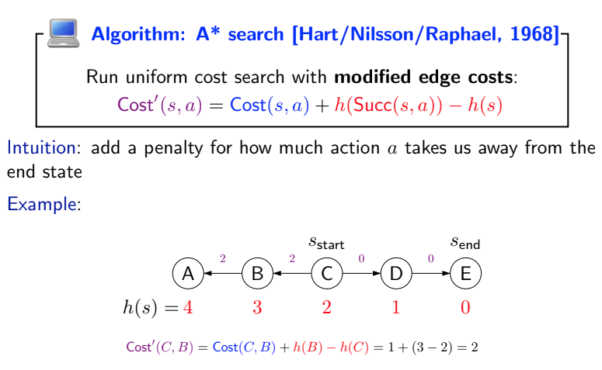
A* search
2
2
0
0
1
1
1
1
Notes:
a b not in the direction
if someone tells me this heuristic function, we can update the cost, a better way of getting to the end
the heuristic is exact the future cost
i can get to e much easier

Slide 35
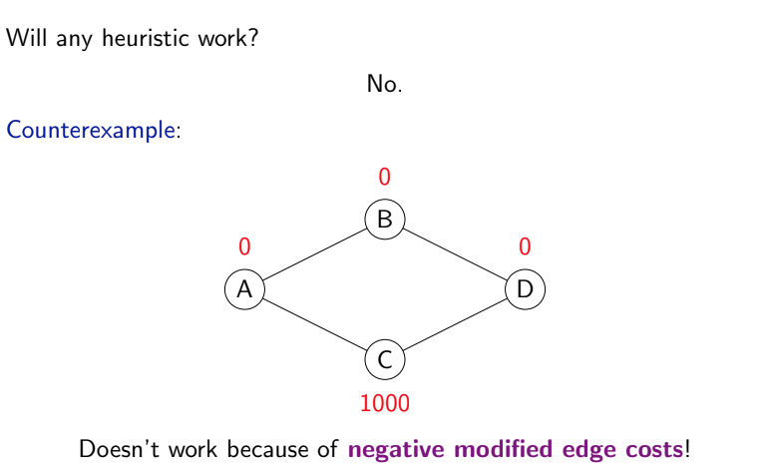
Does any heuristic work?
1
=>1
=>5
5
2
1
=>-999
=>1002
Notes:
doesn’t work for negative edge
heuristic must satisfy certain properties

Slide 36
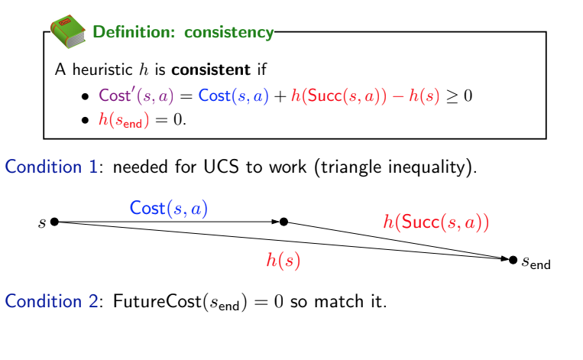
Heuristic conditions

Slide 37
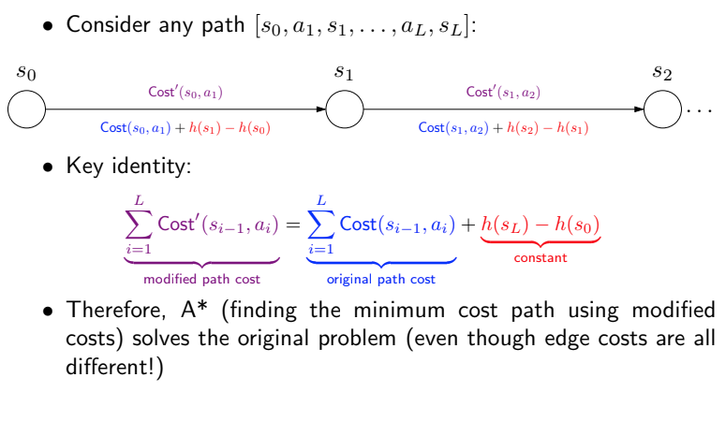
A* is correct
Notes:
therefore A* returns the optimal

Slide 38
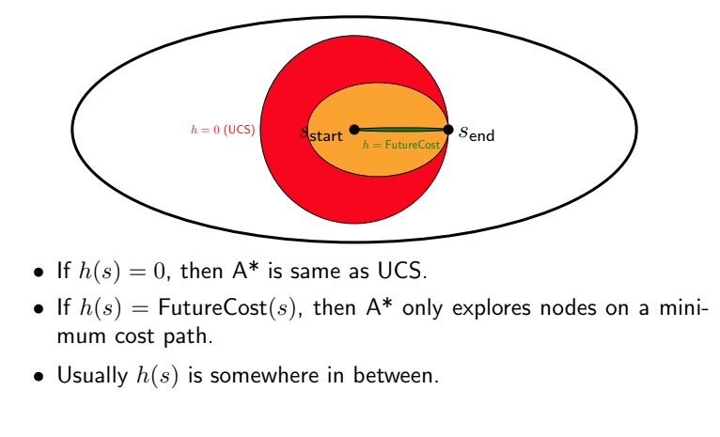
Effect of heuristic
Notes:
In this diagram, each ellipse corresponds to the set of states which are explored by A* with various
heuristics. In general, any heuristic we come up with will be between the trivial heuristic h(s) = 0 which
corresponds to UCS and the oracle heuristic h(s) = FutureCost(s) which is unattainable.

Slide 39
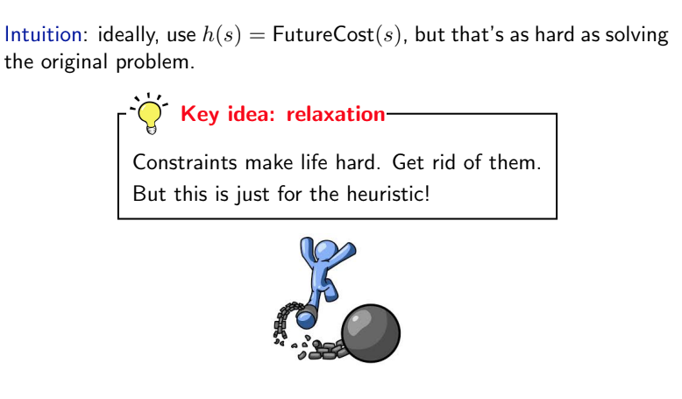
How to come up with heuristics? Relaxation
Notes:
remember h(s) is supposed to be close to futurecost
if we have constraint we can solve much easier problem

Slide 40
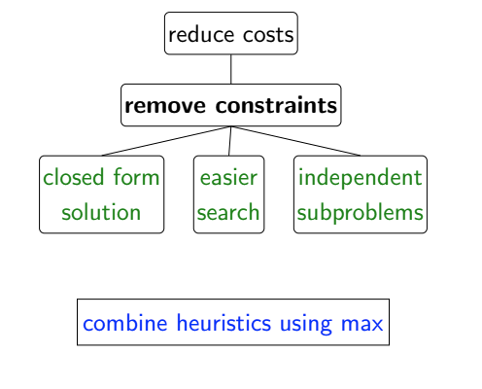
Relaxation overview

Slide 41
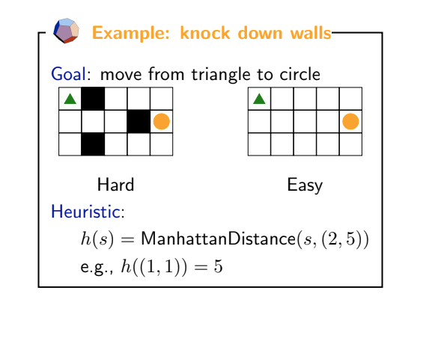
Closed form solution
Notes:
knock down the walls, optimistic view

Slide 42
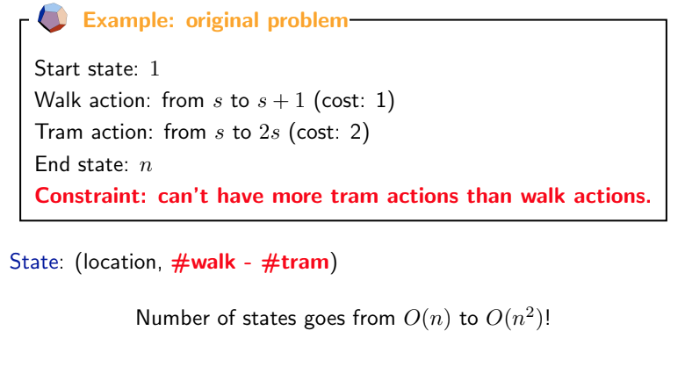
Easier search (no constraint)
Notes:
since if we wanted to respect this constraint, we have to keep track of additional information (augment the state).

Slide 43
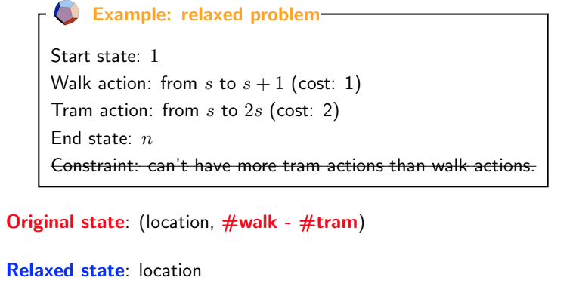
Easier search (no constraint)
Notes:
since if we wanted to respect this constraint, we have to keep track of additional information (augment the state).

Slide 44
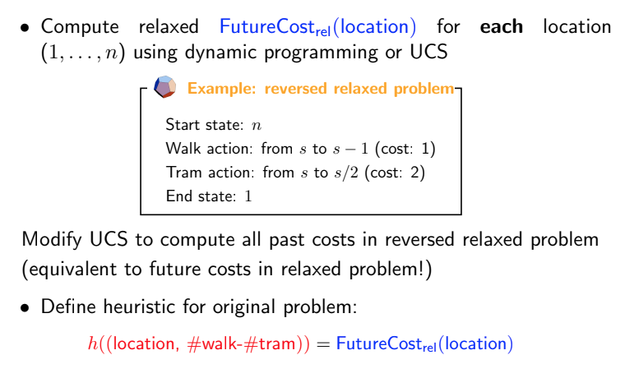
Easier search (no constraint)
Notes:
[demo]

Slide 45
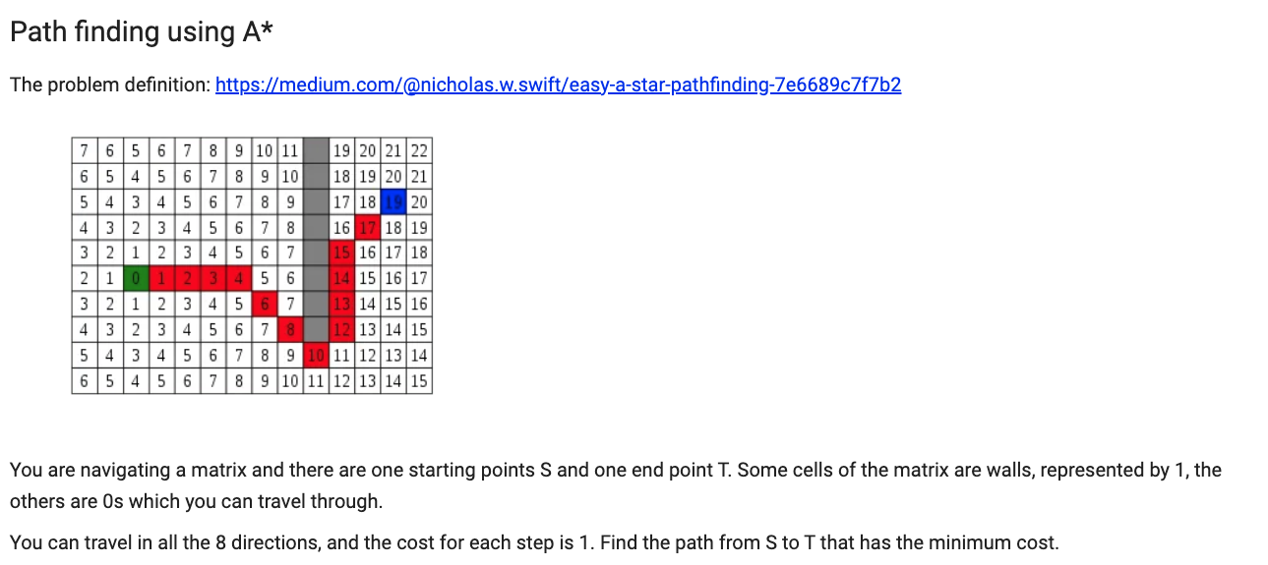
A* demo
Notes:
[demo]

Slide 46
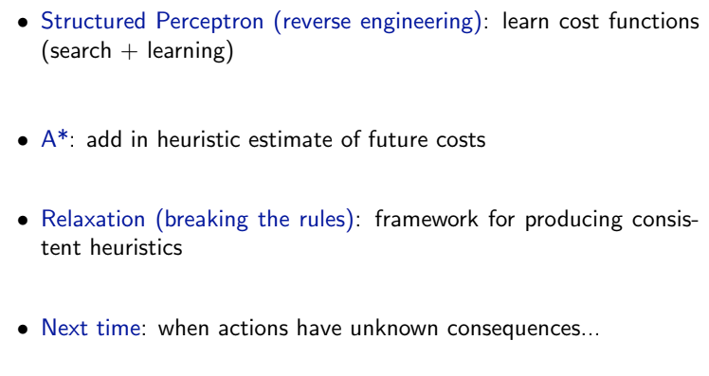
Summary
Notes:
[demo]

Slide 47
References
Abdul Rafae Khan (2022)
CS 541 — Artificial Intelligence
Stevens Institute of Technology
Percy Liang and Dorsa Sadigh (2019)
CS221 — CS221: Artificial Intelligence: Principles and Techniques
Stanford University

Slide 48
The End

